Slide 1
Welcome

Slide 2
Mission
The Mission Statement of a strategic plan is a concise summary of the purpose of an organization and how it intends to realize its vision. It also helps everyone understand what would not be happening if the agency did not exist. The following mission statement confirms the NFTA’s main focus is on high-quality transportation services

Slide 3
Mission
The Niagara Frontier Transportation Authority is a multi-modal entity encompassing a skilled and dedicated workforce. We are firmly committed to providing safe, efficient, professional and sustainable transportation services that enhance the quality of life throughout the Buffalo Niagara region in a manner consistent with the needs of our community

Slide 4
Mission
Aviation
Serves as a catalyst for economic growth by maintaining cost effective, customer oriented, efficient airports to attract and
retain comprehensive and competitive air transportation services
Property
Manage and develop the NFTA-owned real property to optimize the generation of self-supporting discretionary revenue to help support our transportation centers while fostering economic growth

Slide 5
Mission
Surface
Enhance the quality of life of residents and visitors by providing the highest level of safe, clean, affordable, responsive, and reliable transportation through a coordinated and convenient bus and rail system
Support Services
Proactively provide high quality, coordinated, innovative, technological, cost-effective support service solutions for our internal and external stakeholders

Slide 6
Vision
The NFTA is firmly committed to providing safe,
efficient, professional, and
sustainable transportation services that enhance the quality of life throughout the Buffalo Niagara region

Slide 7
Core Values
Diversity, Equity and Inclusion
The NFTA plays a vital role in the Western New York community. An inclusive work environment that supports and fosters a diverse empowered workforce and a supplier base which reflects our region and helps enhance and promote operational effectiveness and our impact on the community.

Slide 8
Core Values
Economic Vitality
The NFTA is committed to operating sustainable business operations that include financial efficiency and revenue maximization. To ensure this, the authority is committed to operating a financially stable operation that is resilient during varied economic cycles. Additionally, financial investments that provide real economic spin off into the surrounding area, as a catalyst for growth.

Slide 9
Core Values
Engaged Workforce
We value our employees. We will continue to invest, develop and empower a workforce that embraces the NFTA values and helps move the region forward.

Slide 10
Core Values
Environmental Stewardship
We are committed to being a leader in sustainability. We are committed to improve air quality, reducing emissions that impact climate change, improve water quality and promoting net zero impact to the environment as we complete energy efficient projects, eliminate waste and embrace technology to reduce the environment footprint in Western New York.

Slide 11
Core Values
Safety and Security
The NFTA maintains the highest level of safety and security for our workers, passengers and the general public.

Slide 12
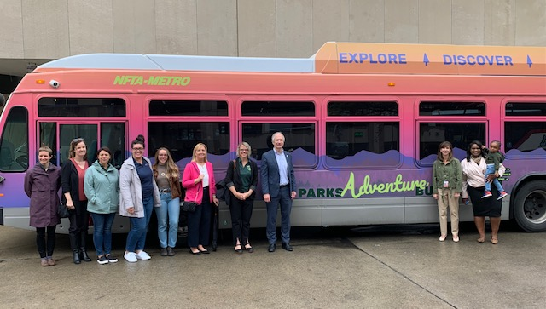
Core Values
Trust, Transparency, and Integrity
Integrity stands at the top of the NFTA’s agenda, and we are committed to strong ethical standards. We follow strict ethical standards for our board of commissioners and all NFTA employees. Employing efficient and effective management practices, the agency is a good steward of public funds. We are an organization that is open and transparent with the highest standards of accountability. Our meeting and our website contain timely information to share with the public in advance of public board and committee meetings.

Slide 13
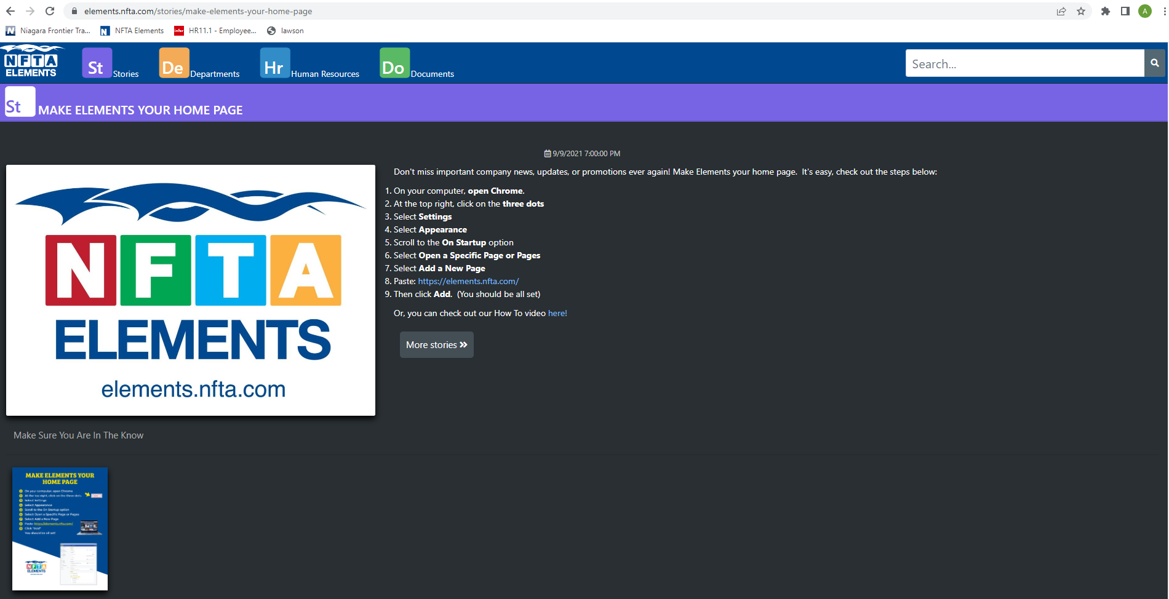
NFTA Elements – https://elements.nfta.com

Slide 14
Referral Program
The NFTA is seeking to hire full-time permanent bus and rail operators (including paratransit operators) as well as full-time Mechanics (at Mechanic A level and above). Effective December 1, 2021, all employees of the NFTA, whether represented by a bargaining unit or not, will be eligible for an employee referral payment through this program for the successful referral of an individual who becomes in the future a full-time employee of the NFTA in a position covered by the Employee Referral Program.

Slide 15
Additional Benefits
Student Loan Forgiveness
Cellular Phone Discounts
EAP – Employee Assistance Program – Child and Family Services
eap.cbsbny.org 716-681-4300 800-888-4162
Free and confidential services to support you and anyone in your household
24/7 telephonic crisis counseling
Solution focused counseling services
Individual coaching
Mediation and conflict resolution services
Counseling and referral for nutritional, financial, legal, elder care, and child care concerns

