Slide 1


NFTA Safety New Hire Orientation

Slide 2

NFTA Safety Video
click here to play

Slide 3
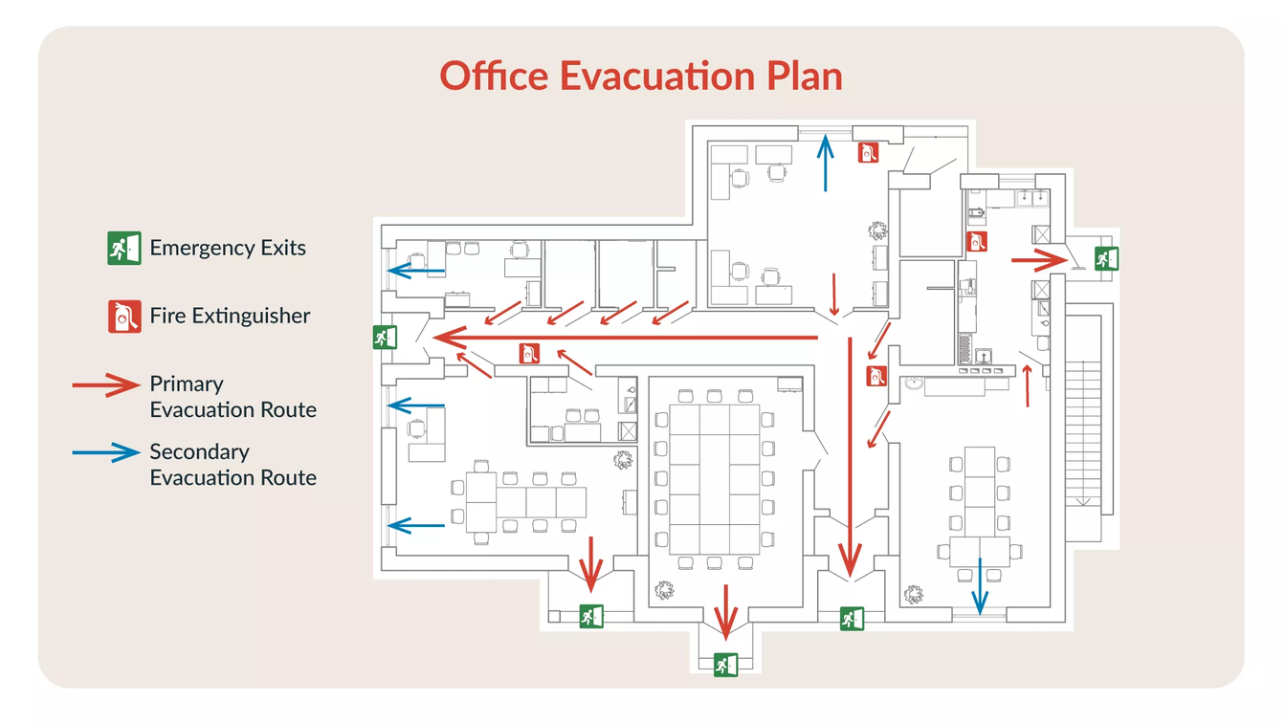
Emergency
Action
Plans
  Every NFTA location has an Emergency Action Plan that will serve as a guide should an incident occur.
  Each location has maps within the facility that detail where employees should exit and assemble if an emergency occurs.
  Evacuate to rally points, take attendance, notify first responders of anyone unaccounted for.
*not an NFTA evacuation plan, photo used for reference

Slide 4


Access to Safety Programs and Policies
DeptData
Documentation
Safety
Employee Safety Programs

Slide 5
NFTA’s Policy on Safety
1.
There are reasonable safeguards to ensure safe working conditions.
2.
Workplace environments are neat, clean, safe, and healthful.
3.
Facilities, equipment, tools, and machines are maintained in good repair.
4.
Safe work methods are studied and developed.
5.
Training is provided and utilized to maximize safe performance.
6.
Compliance with federal, state, and local laws regarding safety and working conditions are sustained

Slide 6


Slide 7


Slide 8
Workplace Violence
•A written policy for workplace violence is in place for NFTA employees:
    Intimidation- an intentional act, whether verbal or non-verbal, that causes another person to fear for their safety or the property or the safety of others, including, but not limited to, stalking, harassing phone calls, name-calling, obscene language, and other abusive behavior. This also includes actions made on social media.
•Weapons are not allowed on company property, regardless of any permits or licenses that one may have. This also includes fake weapons.

Slide 9

Workplace Violence Reporting
  For situations that may present imminent danger, contact Transit Police at 716-855-6405 and/or call 911.
  To report a violation of the workplace violence policy, contact your supervisor to file a workplace violence report.
  Allegations of workplace violence will be reviewed by HSEQ and the Workplace Violence Committee.

Slide 10


Hazard Communication
Employees have the right to understand the chemicals that are being used throughout the authority.
Before buying/utilizing a new chemical, the substance must be approved by the HSEQ Department.
Employees who work with or will be potentially exposed to hazardous chemicals will be receiving hazard communication training. Prior to introducing a new chemical into any department, supervisors will train each employee.
Use only chemicals provided by company, do not bring in chemicals from home.
hazard communication symbols/labeling
All chemical containers must be labeled.

Slide 11


Hazard Communication:
CloudSDS
  Visit the NFTA Elements website – type “NFTA Elements” on search engine
  Visit HSEQ Elements Page- Look for “Hs” square
  Look for information on CloudSDS System, including link to system and How-to-Guide for searching existing approved chemicals and requesting new chemicals

Slide 12

Employee Injuries
•If you are injured on the job, inform your supervisor immediately.
•You will be asked to fill out an employee injury report, do so as soon as possible.
•Be sure to fill out all fields within the employee injury report.

Slide 13
Bloodborne Pathogens
  The NFTA has a written policy in place regarding bloodborne pathogens, which serves to protect employees from contracting disease in the workplace.
  Exposure to bloodborne pathogens can lead to the transmission of diseases, including, but not limited to the Human Immune Deficiency Virus (HIV) and Hepatitis B.

Slide 14

Bloodborne Pathogens: Participating Positions
The following employees are enrolled in the Bloodborne Pathogen Program:
•Metro Maintenance Employees, including supervision
•HSEQ Department (does not include administrative positions)
•Custodians, including immediate supervision
•Transit Police
•Airport Fire & Rescue
•Occupational Health Coordinator
•HR Medical & Drug Testing Staff
•FMD Employees
•MTC Maintenance Employees
•Bus Street Supervisors & Controllers
Bus Operators are not enrolled in the Bloodborne Pathogen Program. Bus Operators should not attempt to touch any item that may contain blood or body fluids. If you see a potentially contaminated item, call Control for further instruction.

Slide 15



Bloodborne Pathogens: Program Participation
If you are in a position where exposure to a bloodborne pathogen is possible, training will be provided to you annually.
All personal protective equipment (PPE) is provided without cost to employees. PPE is chosen based on the anticipated exposure to blood or other potentially infectious materials.
The NFTA offers the Hepatitis B vaccination series to all employees who have occupational exposure to bloodborne pathogens. This vaccination series is optional.

Slide 16

Safety Committees
  The NFTA has nine safety committees that meet monthly to address any employee safety concerns.
  Contact your safety committee representative if you have any matters to be addressed at an upcoming meeting.
  Always report and take action if possible!

Slide 17

Review
•Safety is everyone’s responsibility.
•If you have a question or concern regarding any safety related policies, contact your supervisor or the Safety Department.

Slide 18
Questions?

